Slide 1

Cash and A/R Part 1 - Video

Slide 2
Cash and Cash Equivalents

Slide 3
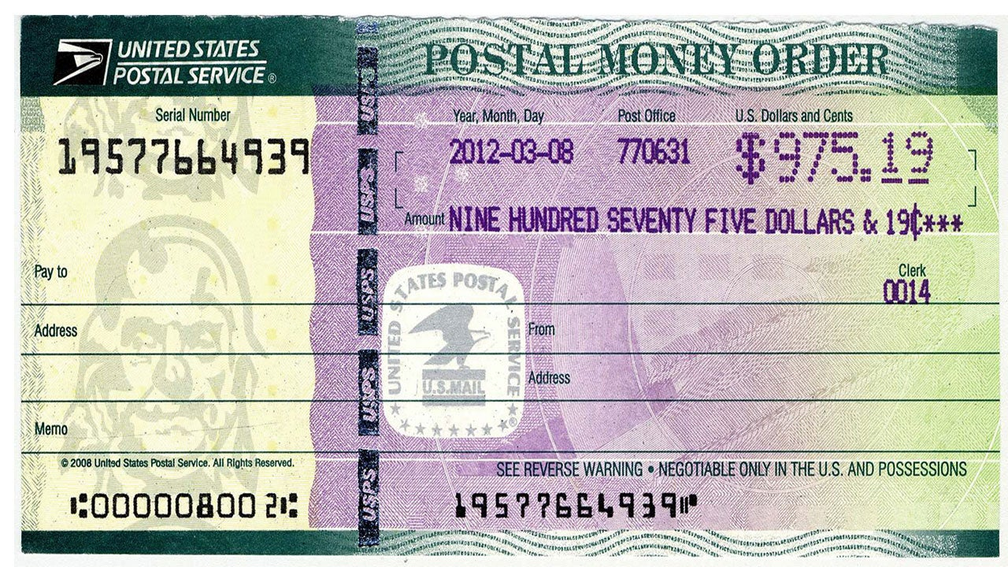
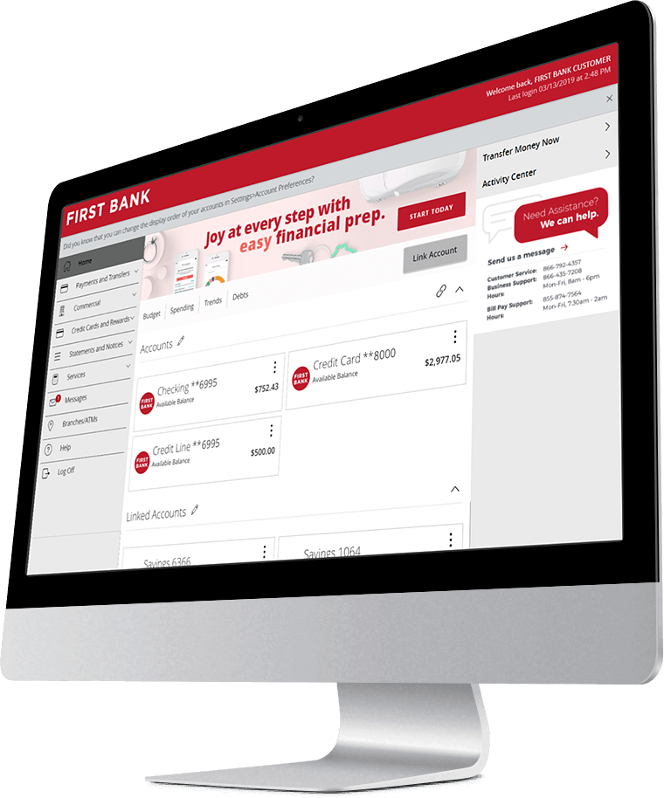


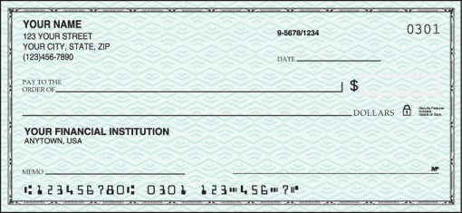
Cash and cash equivalents
Most liquid of assets (always at top of balance sheet).
Must be readily available to pay obligations.
Cash: petty cash, checking and savings accounts, money orders, checks, currency.
Notes:
Important criteria: post-dated checks don’t meet that, traditional CDs don’t meet that.
What are cash equivalents?
Short-term, highly liquid investments that are both readily convertible to known amounts of cash and are so near their maturity (generally < 3 months) that they present insignificant risk of changes in value because of changes in interest rates

Slide 4
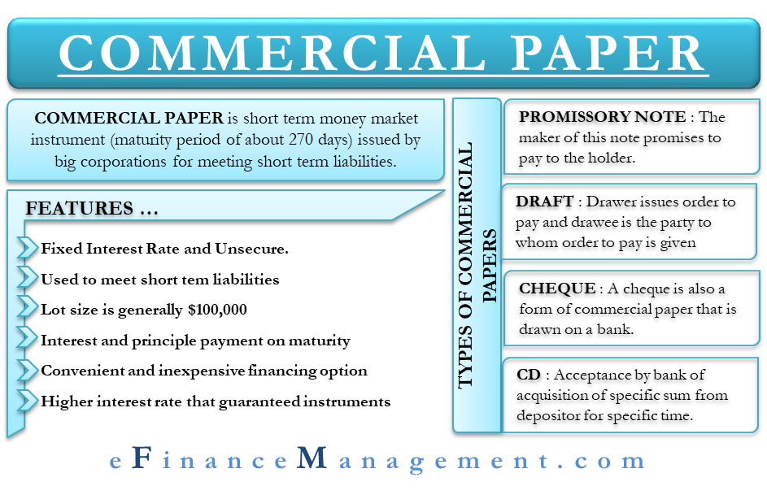
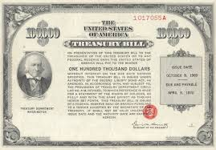
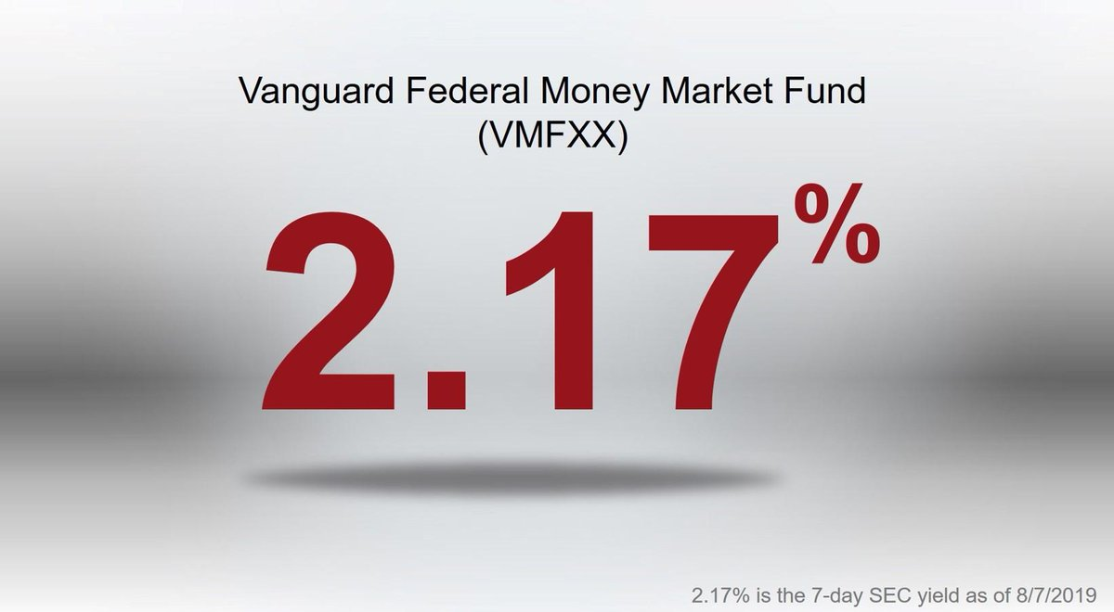
Cash and cash equivalents
Cash equivalents: T-bills, commercial paper, money market funds
Readily convertible to known amounts of cash
So near to maturity that there is little risk of changes in interest rates (<3 months)
Notes:
Important criteria: post-dated checks don’t meet that, traditional CDs don’t meet that.
What are cash equivalents?
Short-term, highly liquid investments that are both readily convertible to known amounts of cash and are so near their maturity (generally < 3 months) that they present insignificant risk of changes in value because of changes in interest rates

Slide 5
Reporting Issues
Reporting: Most firms report “Cash and cash equivalents” as a single item on the balance sheet
Cash Flows Statement reconciles to this amount
A footnote explains the composition of cash and cash equivalents
Overdrafts are liabilities

Slide 6
Restricted Cash
Examples
Cash held in escrow accounts
Cash set aside for dividends/payroll
Bond sinking fund: set aside to retire bonds in the future
Reporting:
Restricted Cash under current assets if used within one year
Restricted Cash under non-current assets if used beyond one year

Slide 7
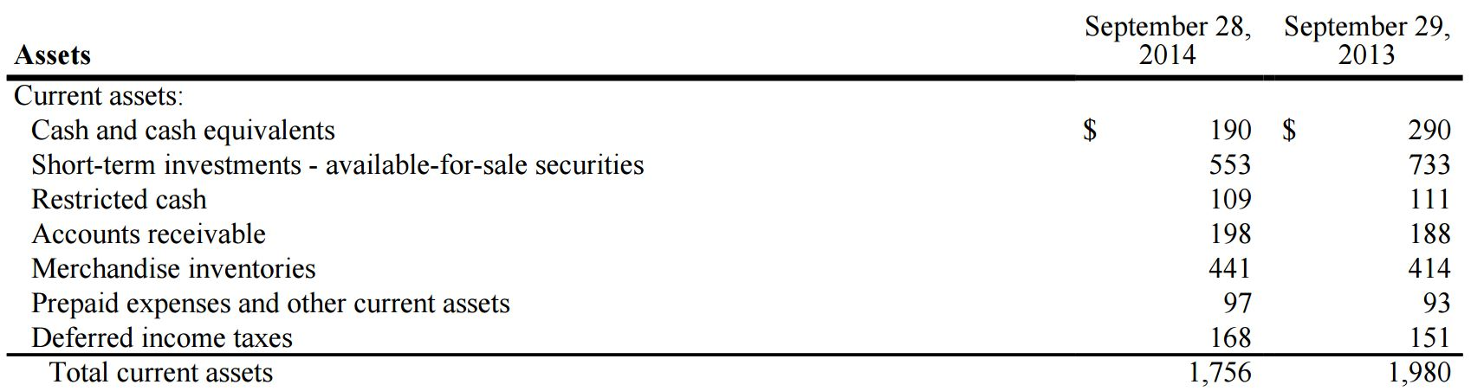
Restricted cash: Whole Foods (2014)
From Notes to the Financial Statements:

Slide 8
Compensating Balances
Examples
Legally binding deposits at lender’s financial institution
Informal agreement to keep a minimum cash balance at lender’s institution
Reporting:
If legally binding, Compensating Balance under current (short-term debt) or non-current assets (long-term debt)
If not legally binding, combined with Cash and disclose in footnotes

Slide 9
Why compensating balances?
Option 1: Bank loans $1,000,000 to Firm, requires firm to maintain $100,000 in restricted cash account.
Option 2: Bank loans $900,000 to firm.
Why not just loan the company less money instead of restricting cash?

Slide 10
Restricted cash example
Example: Bruce Bank loans Marlin Company $1,000,000 for one year at 8% interest. The bank also requires Marlin to keep 10% of the loan on deposit as security. What is the effective interest rate for the loan?
1,000,000 × 0.08 = $80,000 of interest
80,000/(1,000,000-100,000) = 8.89%
*borrow $1,000,000, but have only $900,000 to use (worse effective interest rate)

Slide 11
Closing Thoughts
Cash and cash equivalents are reported together
Restricted cash is reported separately and disclosed
Compensating balances can be legally binding or not, raise effective interest rate

Slide 12
Cash and A/R Part 1 - Video

